Slide 1
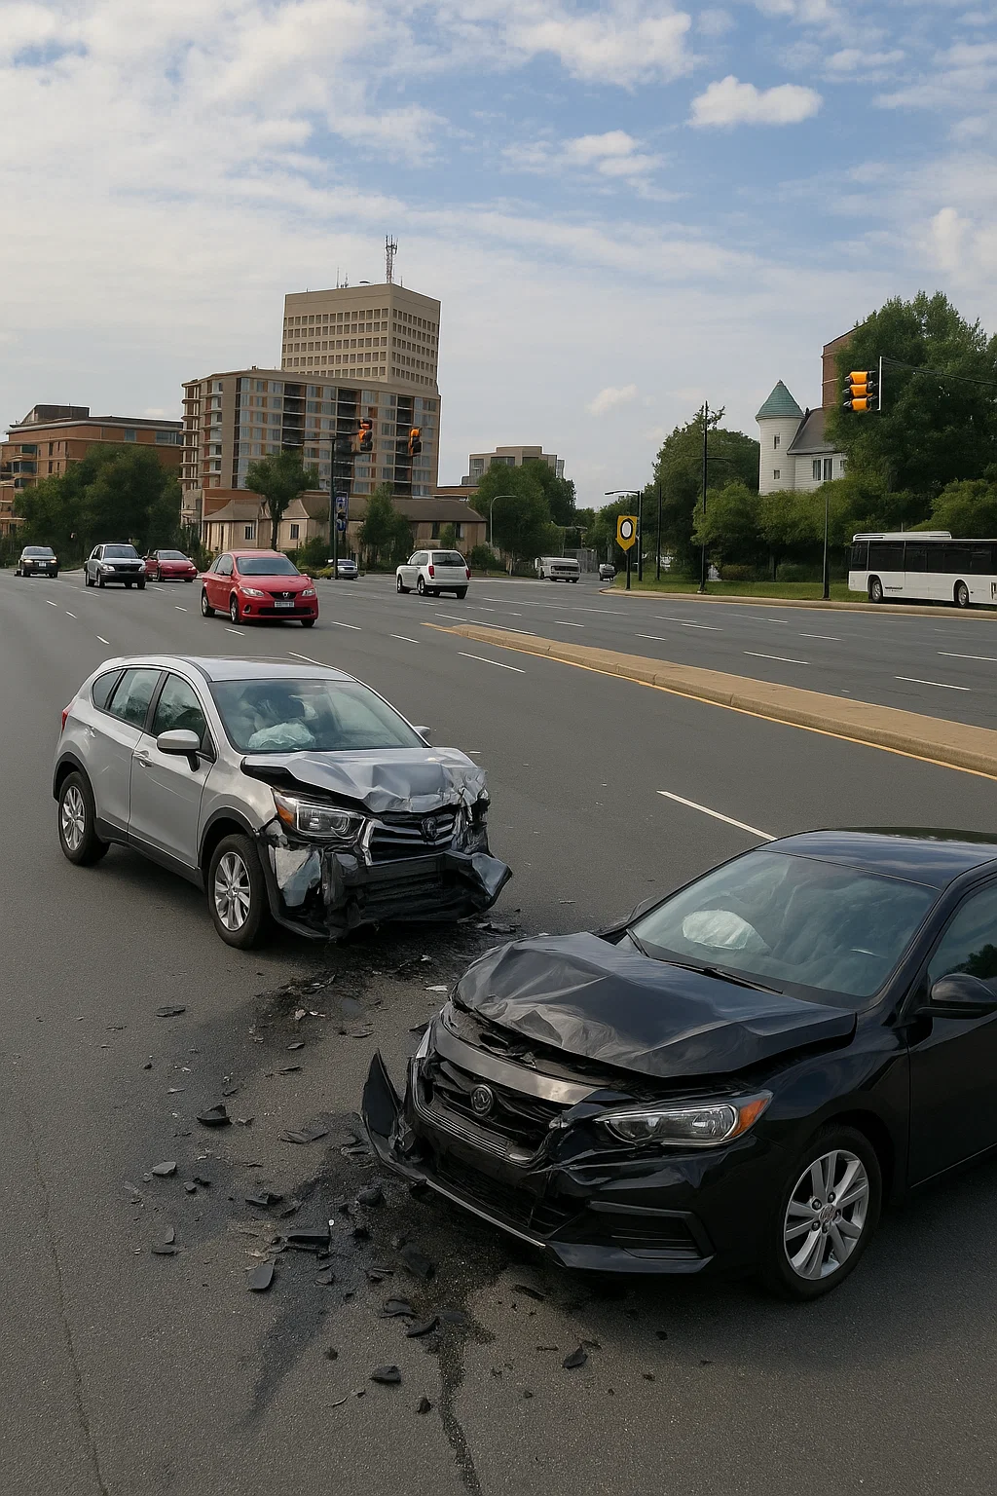
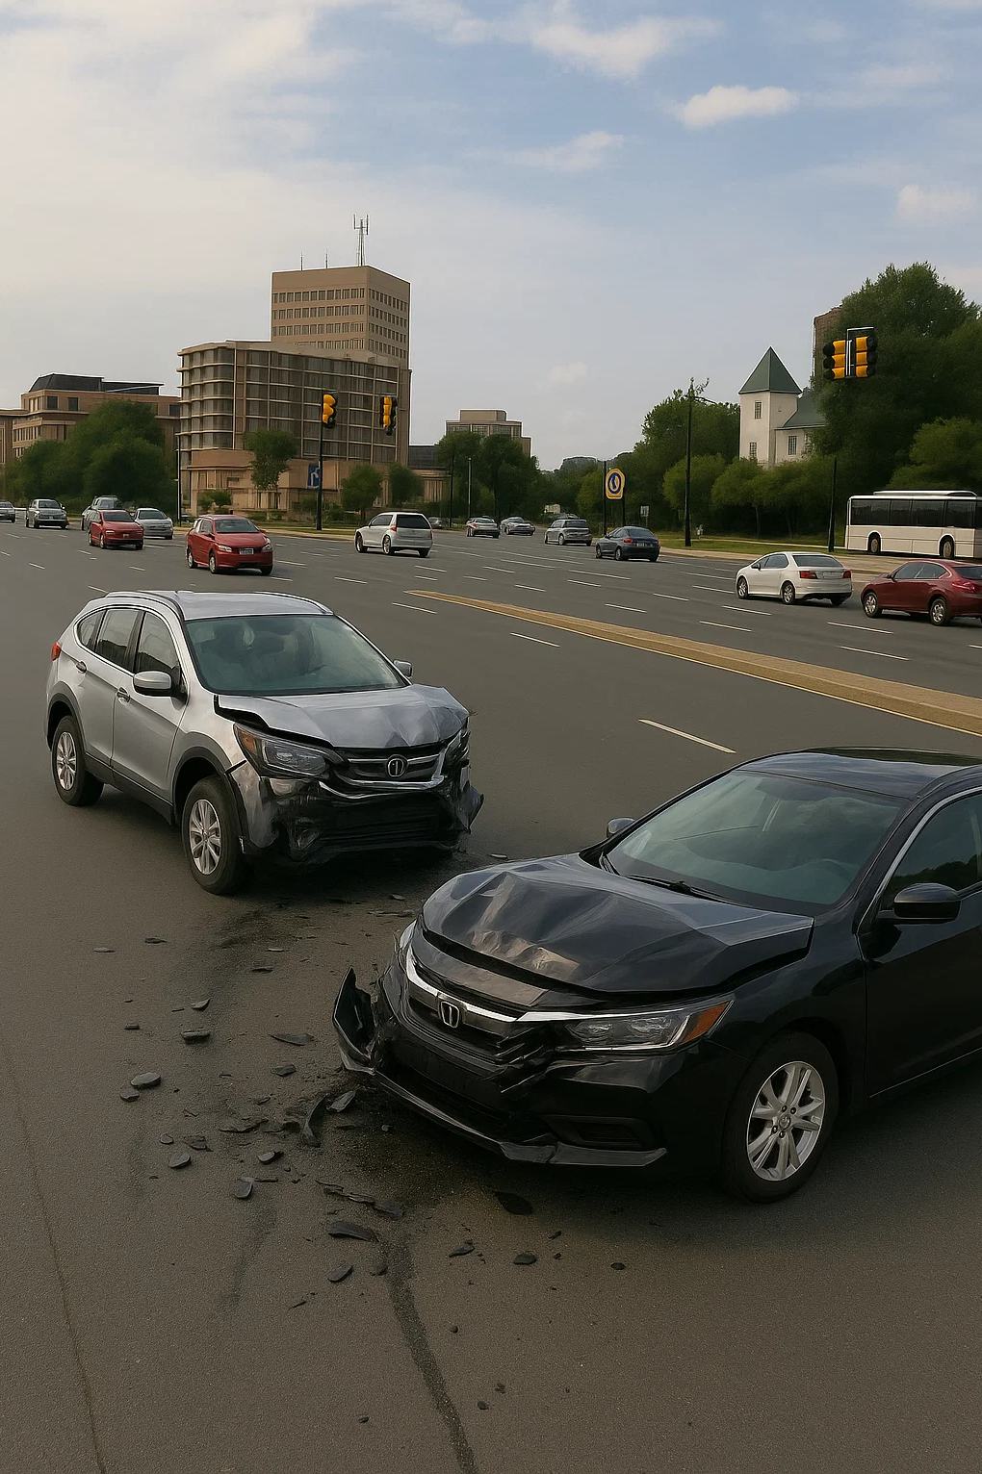

Crash Analysis: Avoiding Impact with Insight
Montgomery College Spring 2025
DATA 205 CRN: 32118 Capstone Experience in Data Science
Betty Liu
Disclaimer: This image is AI-generated and does not depict a real accident out of respect for victim privacy and dignity.

Slide 2

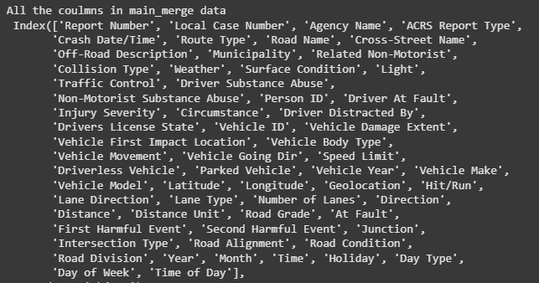
Data
Crashing Reporting- Driver data… (39 features 193k samples) Updated Weekly. April 25th 2025 update https://data.montgomerycountymd.gov/Public-Safety/Crash-Reporting-Drivers-Data/mmzv-x632/about_data
Crashing Reporting- Incidents Data…(37 features 109k samples) Updated Weekly. April 25th 2025 update https://data.montgomerycountymd.gov/Public-Safety/Crash-Reporting-Incidents-Data/bhju-22kf/about_data
The Big Data Merge
62 features 217,809 Samples
2015-April 25th 2025
Data Cleaning
Datetime Standardization: Converted all Crash Date/Time fields to
Python datetime objects
Categorical Normalization: Standardized naming conventions in categorical fields like Weather Condition, and Lighting Condition, Circumstance
Initial Concern: Inconsistent Data Entry
Circumstance field contained
633 unique values
Then reduced to 158 unique values.

Slide 3






Goal
Identify accident hotspots, uncover trends, and analyze risk factors to equip the people of Montgomery County and those passing through with information they can use to make safer decisions, and ultimately help create safer roads for everyone.
Tools
Python
Google Colab
Excel
Tableau Public
Github

Slide 4

Why It Matters
From 2015- April 25th 2025 there was a total of 110,900 reported accidents and there was 195,692 persons involved
Consequences of crashes are significant. People suffer injuries, vehicles are damaged, and traffic grinds to a halt. One crash can disrupt many lives in just a few moments
Crashes aren't just numbers. Each data point represents a real person: a father, mother, son, or daughter whose life was forever changed

Slide 5

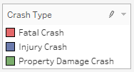
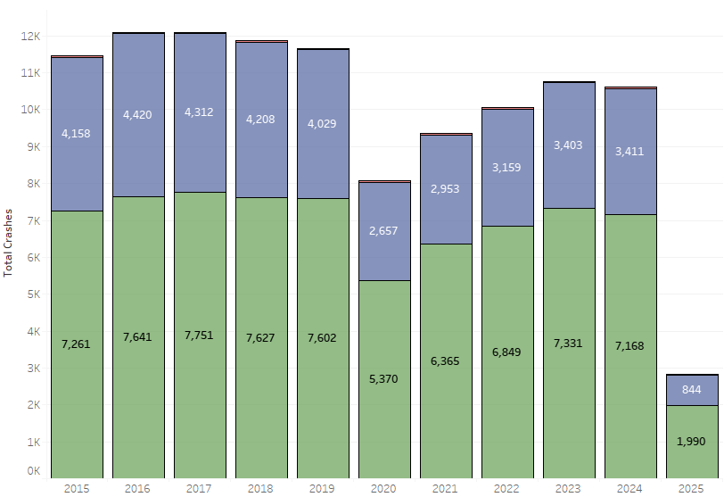
Historical (2015-2025)
Total Reported Crash Types
The majority of crashes were
property damage (~65%)
Significant drop in reported crashes in 2020, likely due to reduced traffic volumes associated COVID-19 pandemic shutdowns
Despite a decrease from 2019 of reported incidents by approximately 31%
The number of fatal incidents increased approximately 46.6%
Crash numbers continued to rise year over year, until more recently
Notes:
property damage cost people time and money
63
63
64
64
65
66
68
68
68
66
69

Slide 6
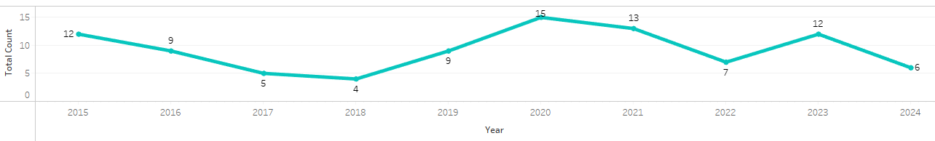
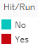
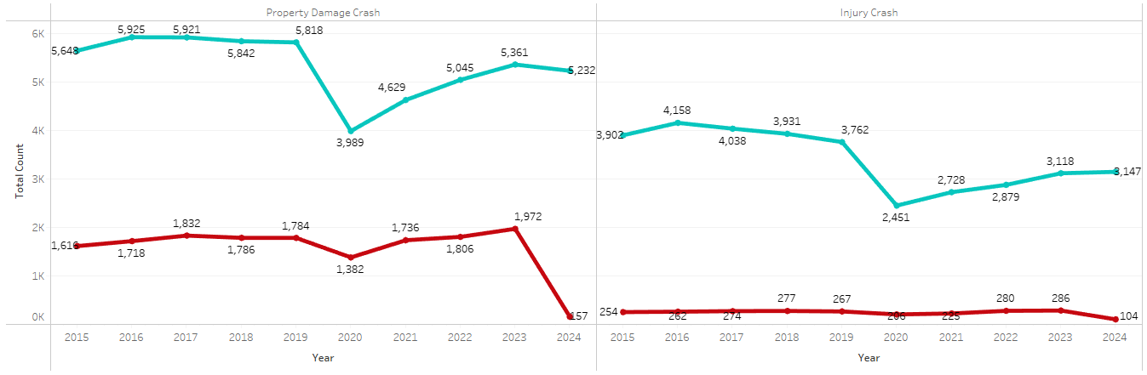
Historical (2015-2024)
Hit and Run: Fatal Crash (2015-2024)
Hit and Run: Property Damage/ Injury Crash (2015-2024)
Notes:
While hit-and-run incidents were present, none led to fatalities. Most hit and run happened with Property Damages And unfortunately, they also accorded where crashes led to Injuries

Slide 7
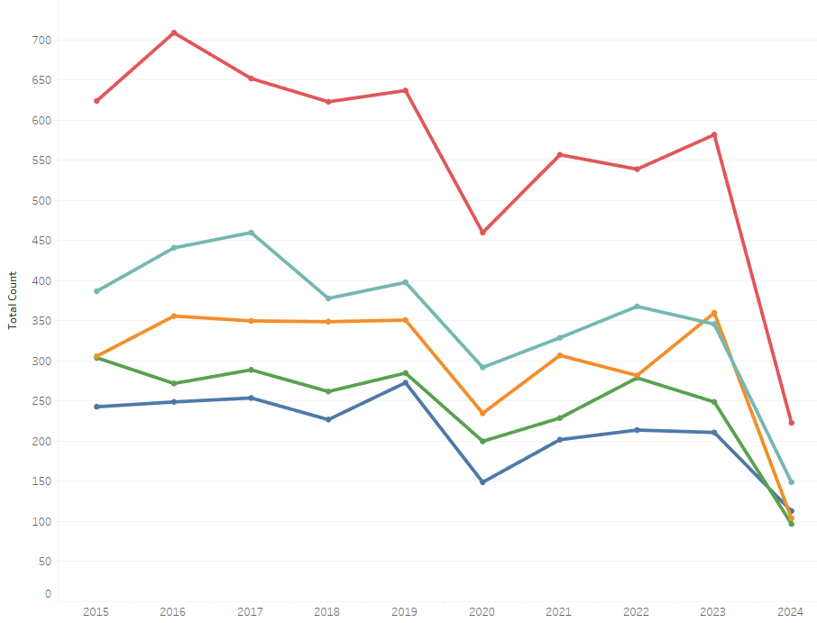
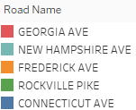
Historical (2015-2024)
Top 5 Road Names
Road Length Comparison
Recent Years (2020-2024)
Georgia Ave is 16.3 miles
New Hampshire Ave is 20.5 miles
→ Georgia Ave is 20% shorter
Despite Georgia Ave being shorter
Year(s)
2020
2021
2022
2023
2024
had
+58%
+69%
+46%
+68%
+50%
More crashes than
New Hampshire Ave
Notes:
Top 5 road names that have the highest accident count
Georgia consistently has a high count that other others.
Georgia has on average 58% more incidents than New Hampshire Ave
Percent Difference=(NH Rate- GA Rate/ NH Rate​)×100

Slide 8
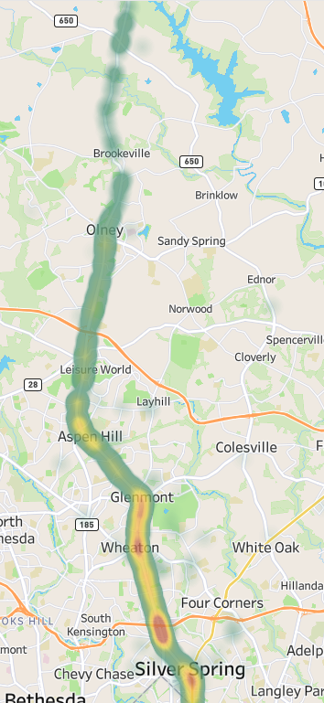
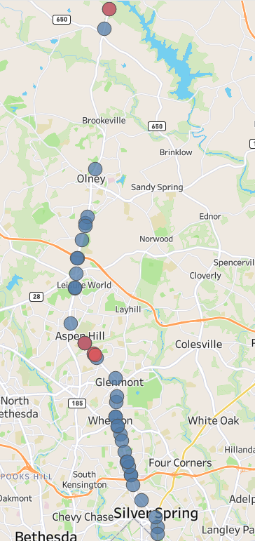
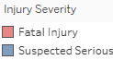
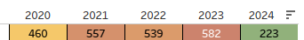
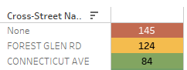
Recent Years (2020-2024)
Georgia Ave
Georgia Ave: 16.3 miles
Year | Accidents per Mile
2020 | 28.2
2021 | 34.2
2022 | 33.1
2023 | 35.7
2024 | 13.7
Georgia Ave - Top 3 Cross Roads
124 is approximately 0.19% of 66,215*
1 in 534 crashes that happen on Georgia Ave happened at Forest Glen Rd
8
Notes:
*value was calculated by averaging all volume reports at that intersection within the selected time frame. MDOT SHA

Slide 9
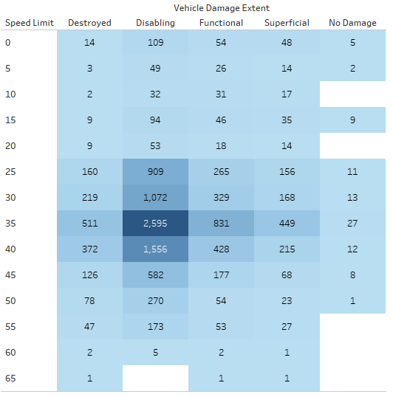
Recent Years (2020-2024)
The 30–40 mph range shows the highest concentration of crashes and most severe vehicle damage (disabling and destroyed).
Suggesting even moderate speed zones can result in significant vehicle damage
Vehicle Damage and Speed Limit
30 MPH
Total Crashes: 1,801
Destroyed: 219 → 12.2%
Disabling: 1,072 → 59.5%
35 MPH
Total Crashes: 4,413
Destroyed: 511 → 11.6%
Disabling: 2,595 → 58.8%
40 MPH
Total Crashes: 2,583
Destroyed: 372 → 14.4%
Disabling: 1,556 → 60.2%
No-damage incidents remain under 1% across all speed limits
45 MPH
Total Crashes: 961
Destroyed: 126 → 13.1%
Disabling: 582 → 60.6%
Notes:
12.7% Destroyed Average in 30-40 mph range
59.5% Disabling Average in 30-40mph range

Slide 10
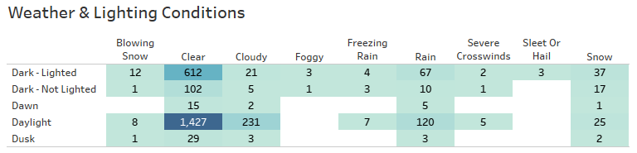
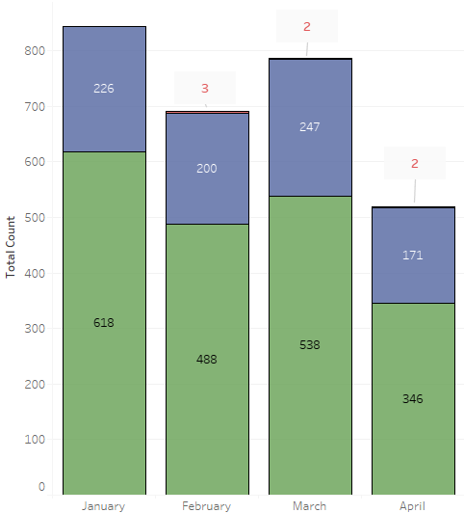
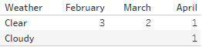
Now (2025)
Total Crash Types
Weather and Lighting Conditions
2,212 crashes over 72* CLEAR days
~ 30.7 crashes per clear day
121 crashes over 4* WINTRY days
~ 30.2 crashes per snowy day
210 crashes over 11* RAINY days
~ 19.1 crashes per rainy day
Fatal Crash Weather
Notes:
Crashes are about equal in clear and rain— showing it’s often not the road, but us
Clear and Snowy days have similar crashes per day after normalizing
Count of days with weather conditions matched to 2025 crash report, based on data from The Weather Channel
Jan 73%
Feb 70%
Mar 68%
April 66% Propety Damage reports

Slide 11

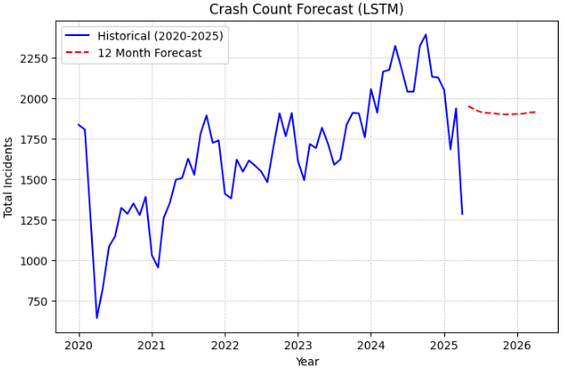
LSTM (Long Short-Term Memory)
This model predicts trends for the next 12 months. It indicates an initial increase followed by a gradual decline toward the end of 2025, with a slight uptick at the start of 2026.
Notes:
LSTM a type of Neural network to forecast the number of crashes per month, based on past crash data from 2020 to 2025 and predict the next year of crash activity
Let's not just predict the future, let's shape it.

Slide 12
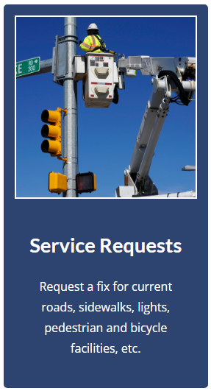
Vision Zero
No loss of life is acceptable. I believe zero is the only number that
honors the total number of fatalities from vehicle accidents.
Montgomery County Agrees
Montgomery County's Goal to End Traffic Deaths
https://www.montgomerycountymd.gov/visionzero/
The County has put resources in place to eliminate serious-injury and fatal collisions on County roads for vehicle occupants' pedestrians, and bicyclists by the end of 2030

Slide 13

Critical Steps to Take After a Crash
Stay Calm
Turn on hazard lights
If possible, move vehicle out of the way of traffic to a safe location
Assess for injuries. If injured, contract emergency services
Notify local police of the accident and obtain a police report
Exchange information
Driver Personal: Names, Contact info, Address
Insurance: Company name, address, phone number, and policy number
Take photos to document the crash scene
Damage to vehicles and/or property.
Accident scene (road conditions, skid marks, debris in roadway, vehicle positions, etc.)
Location identifiers of the accident scene (intersection, address, or exit number.)
Driver and vehicle identification (insurance cards, license plates, etc.)

Slide 14

Acknowledgements
A Large Thank You
Data Science Faculty
Professor Celia Evans – INTRODUCTION TO DATA SCIENCE – DATA 101
Professor Rachel Saidi – DATA VISUALIZATION AND COMMUNICATION – DATA 110
Professor Abdirisak Mohamed – STATISTICAL METHODS IN DATA SCIENCE – DATA 201
Professor Jane E Valentine – CAPSTONE EXPERIENCE IN DATA SCIENCE – DATA 205
Other MC Staff
Professor Gary C. Thai – PYTHON PROGRAMMING – CMSC 206
Special Thanks
To my classmates of DATA 205 for being here and going through this experience with me

Slide 15
References
https://www.gsa.gov/buy-through-us/products-and-services/transportation-and-logistics-services/fleet-management/vehicle-leasing/accidents-and-maintenance/accident-management-center (Steps after an accident)
https://maps.roads.maryland.gov/itms_public/?stationid=S2017150112 (Volume Detail Report)
https://weather.com/weather/monthly/l/4433c656f801f190919b8d258b7dd18125e7b21c99dc22683e1d53839e18ac82 (Weather Details)
https://www.montgomerycountymd.gov/visionzero/background.html (Vision Zero Time Line)
https://www.google.com/maps/place/Montgomery+County,+MD/@39.1361654,-77.3282876,54425m/data=!3m1!1e3!4m6!3m5!1s0x89b6323583b8a387:0x780b190677a96873!8m2!3d39.1547426!4d-77.2405153!16zL20vMGJ4OXk?entry=ttu&g_ep=EgoyMDI1MDUwMy4wIKXMDSoASAFQAw%3D%3D (map of Montgomery County boundaries)

Slide 16
End Presentation
Thank you
Be Safe

